Slide 1
Chapter 3: Identification and Differentiated services
Learning Outcomes
At the end of this chapter, you are expected to:
Discuss the impact of disability and vulnerability on the daily life of persons with disabilities and vulnerabilities.
Elucidate the needs of persons with disabilities and vulnerabilities
Describe the effects of the environment on the life of PWDs and vulnerabilities.
Discuss the intervention and rehabilitation approaches for disabilities and vulnerabilities.
List barriers to inclusive services provisions in different sectors
Describe the role technologies in the life of persons with disabilities
Relate the concept of inclusiveness to their specific profession
Evaluate the inclusiveness of services provided in their specific fields of studies
1

Slide 2
3.1. Impact of Disability and Vulnerability on daily life
A. Factors related to the person
The nature of the disability:- acquired (a result of an accident, or acquired disease difficult to adjust to) or congenital (present at birth)
The individual’s personality:- the individual personality can be typically positive or negative, dependent or independent, goal-oriented or laissez-faire.
The meaning of the disability to the individual: - does the individual define himself/herself by his/her looks or physical characteristics?
The individual’s current life circumstances: - if the individual is happy with their current life circumstance, they are more likely to embrace their disability, whereas if they are not happy with their circumstances, they often blame their disability.
The individual’s support system: - if an individual‘s support from family, a significant other, friends, or social groups have an easier time coping with a disability and thus will not be affected negatively by their disability.

Slide 3
B. Economic Factors and Disability
People with few economic assets are more likely to acquire pathologies that may be disabling.
Economic status affects whether pathology will proceed to impairment e.g. medication limits the options and abilities of someone who requires personal assistance services or certain physical accommodations.
Reduce the appropriate access to rehabilitation services to reduce the degree of potential disability either because they cannot afford the services themselves or cannot afford the cost of specialized transportation services
Limit the options and abilities of someone who requires personal assistance services or certain physical accommodations.
Status of the community may have a more profound impact than the status of the individual on the probability that disability will result from impairment or other disabling conditions.

Slide 4
C. Political factors and disability
The political system, through its role in designing public policy, can and does have a profound impact on the extent to which impairments and other potentially disabling conditions will result in disability.
The extent to which people with impairments and functional limitations will participate in the labor force is a function of the funds spent in training programs, the way that health care is financed, and the ways that job accommodations are mandated and paid for.
The potential mechanisms of public policy are diverse, ranging from the direct effects of funds from the public purse to creating tax incentives.
So that private parties may finance efforts themselves to the passage of civil rights legislation and provide adequate enforcement.

Slide 5
D. Factors psychological of disability (constructs of the psychological environment), including personal resources, personality traits, and cognition.
These constructs affect both the expression of disability and an individual's ability to adapt to and react to it.
1. Social Cognitive Processes
Thoughts, feelings, beliefs, and ways of viewing the world, others, and ourselves.
2. Self-Efficacy (Beliefs about one's abilities)
Are concerned with whether or not a person believes that he/she can accomplish the desired outcome (Bandura, 1977, 1986).
Beliefs about one's abilities affect what a person chooses to do, how much effort is put into a task, and how long an individual will endure when there are difficulties
The highly self-efficacious individual would work harder at tasks (i.e., in physical or speech therapy)

Slide 6
Psychological control/self-regulation
Psychological control, or control beliefs, is akin to self-efficacy beliefs in that they are thoughts, feelings, and beliefs regarding one's ability to exert control or change a situation.
Self-generated feelings of control improve outcomes for diverse groups of individuals with physical disabilities and chronic illnesses.
The individual’s control over themselves depends on the provision of the environments: accessibility or inaccessibility.
Coping patterns:- several coping strategies may be used when a person confronts/managing a stressful situation;
seeking information
cognitive restructuring
emotional expression
wish-fulfilling fantasizing
threat minimization, relaxation, distraction, and self-blame.

Slide 7
Personality disposition/nature
Personality embraces moods, attitudes, and opinions and is most clearly expressed in interactions with other people.
It includes behavioral characteristics, both inherent and acquired, that distinguish one person from another and that can be observed in people's relations to the environment and to the social group
People with an optimistic/hopeful orientation rather than a pessimistic orientation are far better across several dimensions

Slide 8
E. The family and disability
The family can be either an enabling or a disabling factor for a person with a disabling condition.
Even among people with disabilities who maintain a large network of friends, family relationships often are the most central, and families often provide the main sources of support.
This support may be instrumental (errand-running), informational (providing advice or referrals), emotional (giving love and support), economic support to help with the purchase of assistive technologies, and to pay for personal assistance
In all of these areas, friends and neighbors can supplement the support provided by the family.

Slide 9
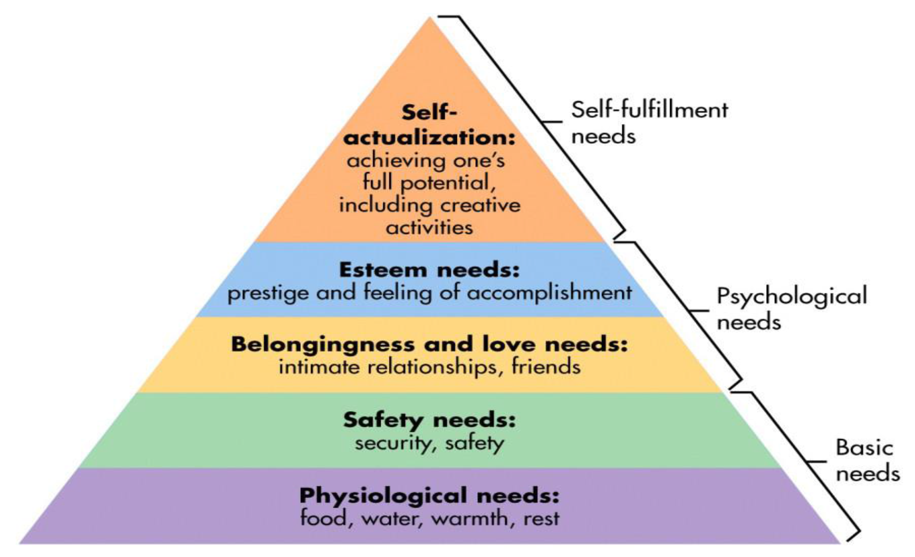
3.2. Needs of persons with disabilities and vulnerabilities
People with disabilities do not all share a single experience, even of the same impairment; likewise, professionals in the same discipline do not follow a single approach or hold the same values.
Maslow‘s model is also valid for persons with disabilities and vulnerabilities, whose needs are similar to those of ordinary persons.

Slide 10
3.2.1.The basic needs of persons with disabilities and vulnerabilities
The needs of PWDS and vulnerabilities differ depending on different factors.
To ensure equality for all within our society the following may be involved
Full access to the Environment (towns, countryside & buildings)
An accessible Transport system
Technical aids and equipment
Accessible/adapted housing
Personal Assistance and support
Inclusive Education and Training
An adequate Income
Equal opportunities for Employment
Appropriate and Accessible Information
Advocacy (towards self-advocacy)
Counseling
Appropriate and Accessible Health Care «

Slide 11
3.2.2. Social Needs of Persons with Disabilities and Vulnerabilities
Social protection plays a key role in realizing the rights of persons with disabilities and vulnerabilities of all ages
Social protection measures may include poverty reduction schemes; cash transfer programs, social and health insurance, public work programs, housing programs, disability pensions, and mobility grants.
Mainstream and/or specific social protection schemes may be required
Previous methods of addressing benefits for persons with disabilities have shown limited progress in overcoming the deeply-rooted social structures and practices that hinder opportunities for persons with disabilities.
Consequently, social protection needs to move beyond traditional welfare approaches to intervention systems that promote active citizenship, social inclusion, and community participation while avoiding paternalism and dependence.

Slide 12
3.2.3.Gender and disability
The importance of work and the daily activities required for living in the country are paramount in considering gender.
For males and females with disabilities and vulnerable groups, WORK is universally seen as important, whether paid work or voluntary.
When the work interests of men with disabilities are similar to those of others around them, their identity as a -man becomes more valuable to the community.
Many males and females with disabilities have creativity and skill in finding ways to do things and consequently being able to build friendships with other men in their communities.
Work, particularly paid work, is also important for many of the female contributors.
Sustaining this in the face of community views about disability is at times difficult, particularly when it is balanced with expectations of traditional women‘s roles of homemaking and childcare

Slide 13
3.2.4.Identity and disability
Disability as part of an individual‘s identity is seen by some as a struggle.
An acquired disability is experienced as challenging the nature of one‘s internal pre-established identity and as a struggle to change the perceptions and attitudes of others and the physical environment in which a person lives.
Relations with family, friends, and communities often provided a contradictory landscape, where a person has to negotiate his/her new disabled identity yet, at the same time, is able to draw upon previous shared experiences to become re-embedded in friendships and communities.
Finding ways to gain value in the local community with a disability is an ongoing and, too often, difficult journey.
It is these very journeys that create one‘s identity and the relational nature of this identity to the rural landscape.

Slide 14
3.2.5. Belongingness and disability
It is a complex concept involving an attachment to place, relationships with others, a sense of safety, common values, and a shared and/or developing history.
Family relationships as a means of connecting to the community and being known by others, and knowing others outside the family are important.
Different kinds of relationships contributed to this sense of belonging, ranging from the more superficial nodding acquaintances to specific informal support from known others, to the intimacy of close friends and kin.
Rurality was once the site of exclusion, rather than belonging, where identity and gender were disregarded in favor of ensuring the protection of people with disabilities and of the society in which they lived.
People with disabilities and marginalized groups feel isolated.
Some persons with disabilities have actively sought to migrate to urban environments, to escape from the confines and constraints of small rural environments, and to build broader social networks away from the farm.

Slide 15
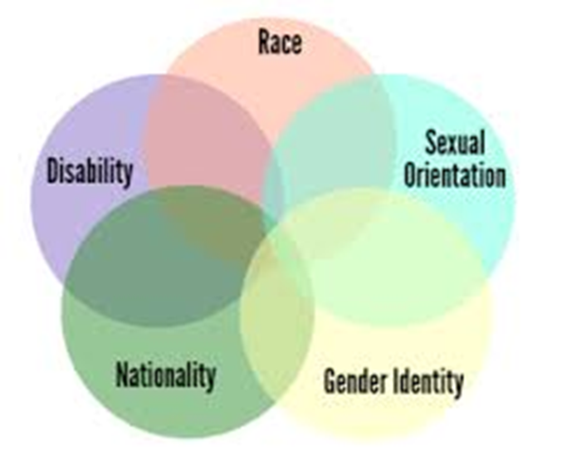
3.2.6. Intersectionality
Social structures and norms surrounding age are particularly significant, shaping the kind of lives people have and their experience of gender and identity.
Age matters too in terms of the support that family and services can offer in a rural environment and the types of age-appropriate opportunities that can be facilitated in the person’s home, family, and community.
The wider contextual values and economic and social changes have also impact the lives of persons with disabilities.
Religious values that shape the way disability is constituted in some countries are a powerful influence on the way PWDs are able to live their lives.
These values intersect with societal expectations of gender roles.

Slide 16
3.3.1 Barriers to health care for persons with disabilities and vulnerable groups
Prohibitive cost: affordability of health services and transportation are the main reasons why people with disabilities do not receive needed health care
Limited availability of services: the lack of appropriate services for people with disabilities is a significant barrier to health care.
Physical barriers: uneven access to buildings, inaccessible medical equipment, poor signage, narrow doorways, internal steps, inadequate bathroom facilities, and inaccessible parking areas create barriers to health care facilities.
Inadequate skills and knowledge of health workers: people with disabilities were more than twice as likely to report finding health care provider skills inadequate to meet their needs, four times more likely to report being treated badly, and nearly three times more likely to report being denied care.

Slide 17
3.3.2. Addressing inclusive barriers to health care
Governments and professionals can improve health outcomes for people with disabilities by improving access to quality, affordable healthcare services, which make the best use of available resources.
As several factors interact to inhibit access to health care, reforms in all the interacting components of the health care system are required.
Policy and legislation: assess existing policies and services, identify priorities to reduce health inequalities, and plan improvements for access and inclusion.
Financing: where private health insurance dominates health care financing, ensure that people with disabilities are covered and consider measures to make the premiums affordable.
Service delivery: provide a broad range of modifications and adjustments (reasonable accommodation) to facilitate access to health care services.
Human resources: integrate disability inclusion education into undergraduate and continuing education for all healthcare professionals.

Slide 18
3.4. Rural environment, Disability, and Vulnerability
Since the larger population of Ethiopia (>85%) is an agricultural community, the life and aspirations of disabled and vulnerable groups highlight both the pull and the push of rural living without appropriate services and support.
Persons with disabilities, vulnerable and marginalized groups living in rural areas have double disadvantaged due to their impairments and vulnerabilities and unfavorable physical and social environment.
Professionals who are working in rural areas should work in collaboration accordingly.
More specifically, these groups of people have been excluded from agricultural work due to its naturally high demand for labor and lack of technologies, and well-organized support from professionals.

Slide 19

3.4.1 Creating a welcoming (Inclusive) Environment
External environmental modifications can take many forms.
These can include assistive devices, alterations of a physical structure, object modification, and task modification.
Environmental modifications may well be an effort at primary prevention because the equipment may provide a safety net and prevent disabling conditions that can occur through lifting and transfer of individuals who may not be able to do it by themselves.
Rehabilitation must place emphasis on addressing the environmental needs of people with disabling conditions.
Environmental strategies can be effective in helping people function independently and not be limited in their social participation, work, leisure, or social interactions as a spouse, parent, friend, or coworker.
Examples of environmental modification are as indicated in the next slides

Slide 20


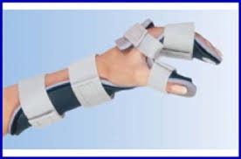
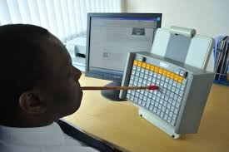
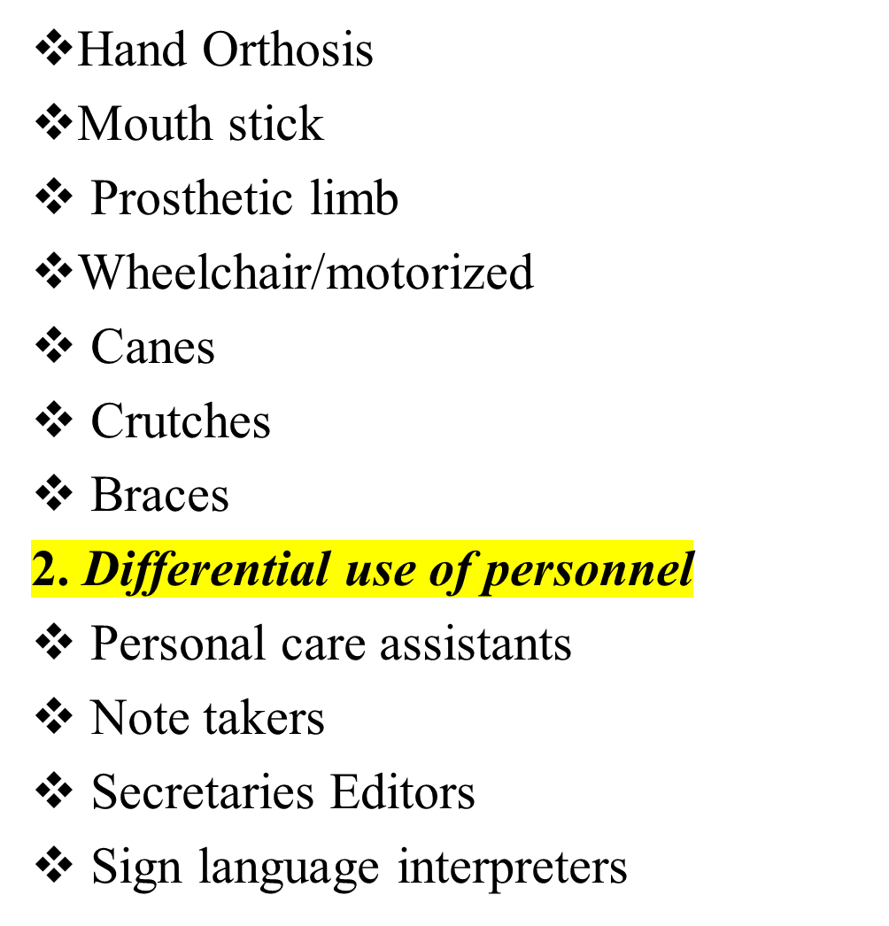

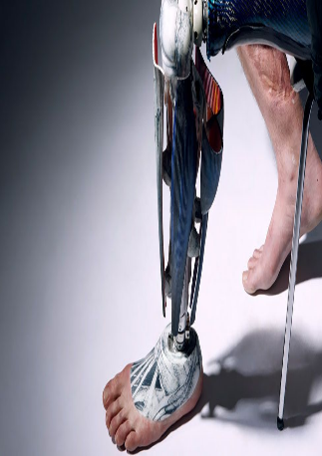
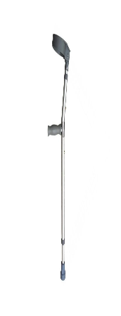
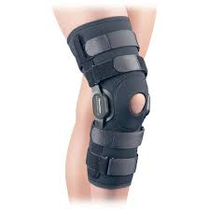

Telephone amplifier
Voice-activated computer
Closed/real-time captioning (provides deaf & hard of hearing people immediate access to spoken language and enables participation in dialogue with others)
Computer-assisted note taker
Print enlarger
Reading machines
Books on tape
Sign language or oral interpreters
Braille writer
Cochlear implant
Communication boards FM, audio-induction loop, or infrared systems

Slide 21


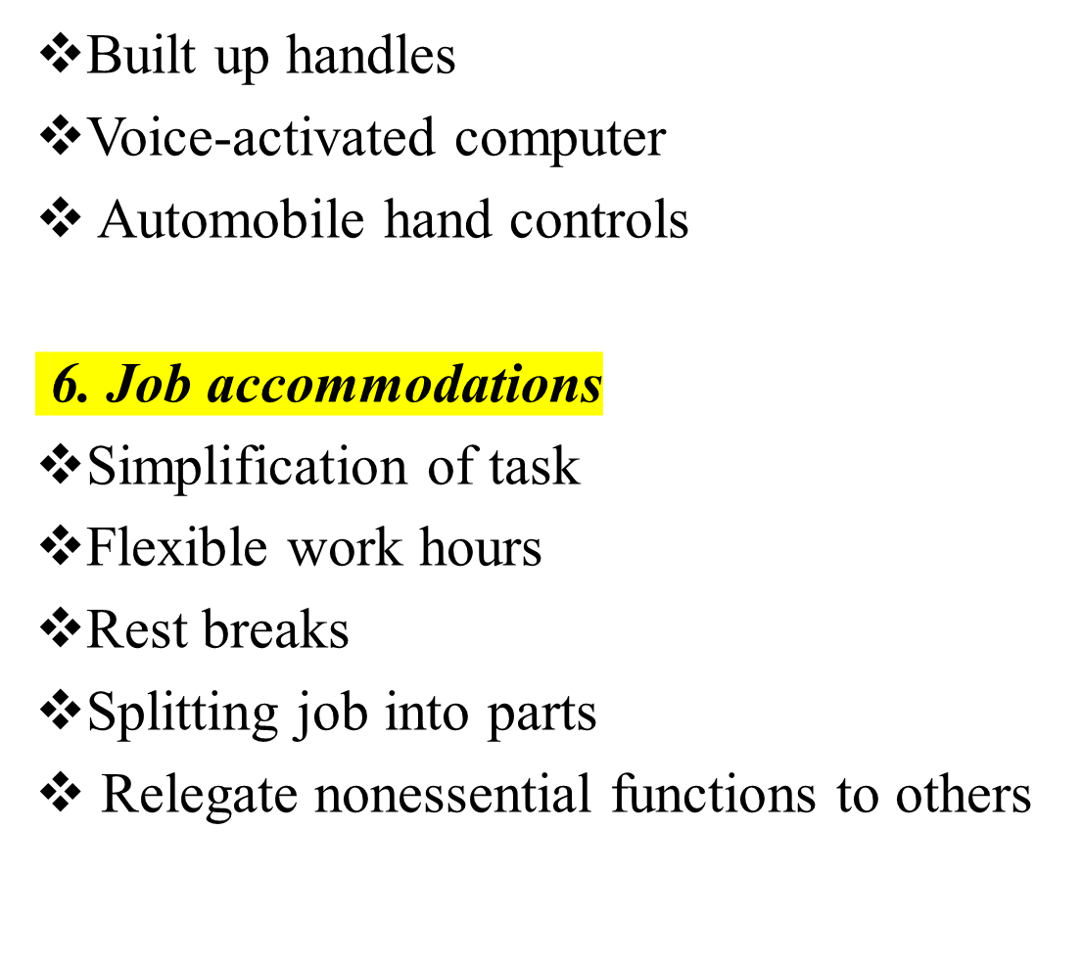
Ramps Elevators
Wide doors
Safety bars
Nonskid floors
Sound-reflective building materials
Enhanced lighting
Electrical sockets that meet appropriate reach ranges
Hardwired flashing alerting systems increased textural contrast/LED lighting

Slide 22
3.4.2. Strategies for Disability inclusive intervention and rehabilitation Prevention
Prevention of conditions associated with disability and vulnerability is a development issue.
Attention to environmental factors – including nutrition, preventable diseases, safe water and sanitation, and safety on roads and in workplaces – can greatly reduce the incidence of health conditions leading to disability.
A public health approach distinguishes:
Primary prevention: – actions to avoid/remove the cause of a health problem in an individual or a population before it arises.
Secondary prevention (early intervention): – actions to detect health and disabling conditions at an early stage in an individual or a population, facilitating cure, reducing or preventing spread, or reducing or preventing its long-term effects
Tertiary prevention (rehabilitation): – actions to reduce the impact of an already established disease by restoring function and reducing disease-related complications (e.g., rehabilitation for children with musculoskeletal impairment).

Slide 23
4. Implementing the Twin-track Approach (it involves the following)
Track 1: Mainstreaming disability as a cross-cutting issue:- within all key programs and services (education, health, relief, and social services, microfinance, infrastructure, and camp improvement, protection, and emergency response) to ensure these programs and services are inclusive, equitable, non-discriminatory, and do not create or reinforce barriers.
Track 2: Supporting the specific needs of vulnerable groups with disabilities to ensure they have equal opportunities to participate in society.
This is done by strengthening referral to both internal and external pathways and ensuring that sector programs to provide rehabilitation, assistive devices, and other disability-specific services are accessible to persons with disabilities and vulnerable groups and adhere to protection standards and inclusion principles.

Slide 24
3.4.3. Implement Disability Inclusive Project/Program
Education and vocational training –inclusive Education realizes the universal right to education for all, meaning all mainstream education services need to be supporting children and persons with disabilities.
Health –early identification role to ensure children and persons with impairments have timely access to health services and referral rehabilitation support.
Relief and social services –vulnerable groups and people with disabilities and their families need to be able to access relief support.
Infrastructure and camp improvement, shelter, water and sanitation, and environmental health – universal design concepts must be considered in all infrastructure and construction programs and projects.
Infrastructure and camp improvement, shelter, water and sanitation, and environmental health – universal design concepts must be considered in all infrastructure and construction programs and projects.

Slide 25
Livelihoods, employment, and microfinance –it is crucial that specific sectors responsible for livelihood programs and projects to make accessible to all vulnerable and people with disabilities.
Protection – marginalized groups and people with disabilities may face risks and vulnerabilities to experiencing violence, exploitation, abuse, neglect, and violation of rights and therefore need to be specifically considered and included in protection programs and projects.
Humanitarian and emergency response – the disproportionate effect of emergency and humanitarian situations on vulnerable groups and people with disabilities should be reflected in the design and implementation of humanitarian projects.
«

Slide 26
3.4.4. Implement effective Intervention and Rehabilitation
Rehabilitation interventions promote a comprehensive process to facilitate the attainment of the optimal physical, psychological, cognitive, behavioral, social, vocational, avocational, and educational status within the capacity allowed by the anatomic or physiologic impairment, personal desires, & life plans, and environmental (dis)advantages for a person with a disability.
Consumers/patients, families, and professionals work together as a team to identify realistic goals and develop strategies to achieve the highest possible functional outcome, in some cases in the face of a permanent disability, impairment, or pathologic process.
Rehabilitation requires goal-based activities &, more recently, measurement of outcomes.
A broad range of measurement tools have been developed for use within rehabilitation, and these standardized tools, along with objective measures of performance are typically documented through the course of the intervention

Slide 27
3.4.4.1 Components of Rehabilitation Interventions
A variety of professionals/Multiple Disciplines who participate in and contribute to the rehabilitation process within a team approach are required as follows:
Physician: -to manage the medical and health conditions of the patient/consumer within the rehabilitation process, providing diagnosis, treatment, or management of disability-specific issues.
Occupational Therapists:- typically work with patients/consumers through functional activities in order to increase their ability to participate in activities of daily living and instrumental activities of daily living in school and work environments, using a variety of techniques.
Physical Therapists:- assess movement dysfunction and use treatment interventions such as exercise, functional training, manual therapy techniques, gait and balance training, assistive and adaptive devices and equipment, and physical agents, including electrotherapy, massage, and manual traction.
Speech & Language Therapist: -assess, treat, & help to prevent disorders related to speech, language, cognition, voice, communication, swallowing etc.

Slide 28
Audiologists:- Audiologists identify, assess, manage, and interpret test results related to disorders of hearing, balance, and other systems related to hearing.
Rehabilitation Nurses:- are experts in bladder management, bowel management, and skin care, and they provide education to patients and families about these important areas and also medications to be used at home after discharge.
Social Workers:- provide case management or coordination for persons with complex medical conditions and needs; help patients navigate the paths between different levels of care; refer patients to legal, financial, housing, or employment services; assist patients with access to entitlement benefits, transportation assistance, or community-based services; identify, assess, refer, or offer treatment for such problems as depression, anxiety, or substance abuse; or provide education or support programming for health or related social problems.
Case Managers:- these professionals collaborate with all service providers and link the needs and values of the patient/consumer with appropriate services and providers within the continuum of health care.

Slide 29
Rehabilitation Psychologists:- assists the individual (and family) with any injury, illness, or disability that may be chronic, traumatic, and/or congenital in achieving optimal physical, psychological, and interpersonal functioning
Neuropsychologists:- these professionals possess specialized skills in testing procedures and methods that assess various aspects of cognition (e.g., memory, attention, language), emotions, behaviors, personality, effort, motivation, and symptom validity.
Therapeutic Recreation Specialists:- provide treatment services and recreation activities for individuals with disabilities or illnesses.
Rehabilitation Counselors:- assist persons with both physical and mental disabilities, and cover the vocational, psychological, social, and medical aspects of disability, through a partnership with the individuals served.
Orthotists and Prosthetists:- the orthotist fabricates & designs custom braces or orthotics to improve the function injury/impairment through the healing process and the prosthetist works with those with neuromuscular or musculoskeletal impairments, or to stabilize individuals with partial/total limb absence/amputation to enhance their function by use of a prosthesis (artificial limb, prosthetic device).

Slide 30
3.4.4.2.Additional Rehabilitation Professionals
Other rehabilitation professionals who might be considered members of the team include nutritionists, spiritual care, rehabilitation engineer, music therapist, dance therapist, child-life specialists, hospital-based school teachers, massage therapists, kinesiologists, and trainers, among others.
A person with a disability and his/her family:-personal and family/support system goals, family/friend support, and community resources are driving forces regarding goals and discharge planning within the rehabilitation process.
Community-Based Rehabilitation:- promotes collaboration among community leaders, people with disabilities and their families, and other concerned citizens to provide equal opportunities for all people with disabilities in the community and to strengthen the role of their organization.
Currently, three main meanings are attached to the notion of CBR:
People taking care of themselves,
a concept and an ideology
Community-based rehabilitation

Slide 31
3.4.4.3.Assistive Technologies (AT)
Persons with disabilities and vulnerabilities utilize AT to enhance the performance of their daily living tasks-communication, vision, hearing, recreation, movement, seating and mobility, reading, learning, writing, and studying, as well as controlling and accessing their environment.
Assistive Technology varies from low-tech devices such as a cane or adapted loop to high-tech systems such as assistive robotics or smart spaces.
Currently, the most popular technologies for Persons with disabilities and Vulnerabilities are simple; examples of mobility-enhancing equipment include wheelchairs, communication via mobile telephones and computers, and voice-activated smart devices to enhance environmental control.
Advances in communication and information technologies further support the development of new, more complex technologies such as the utilization of smart wheelchairs, assistive robots, and smart spaces.

Slide 32
3.4.4.3.1.AT and Design Methods
Given the requirements of functionality, safety, and comfort, the design of AT for Persons with disabilities and Vulnerabilities requires both excellent engineering capacities and relevant knowledge about Persons with disabilities and Vulnerability characteristics.
Product developers must be fully aware of the needs, wants, and capabilities of Persons with disabilities and Vulnerabilities populations, as well as limitations associated with each handicap.
Numerous design methods have been suggested to assist in the process of AT development.
Most widely known are user-centered design and universal design, which are discussed as follows:

Slide 33

3.5.1. Barriers to employment
Barriers to the employment of persons with disabilities take many forms and operate at many levels, both within and beyond the workplace itself.
Persons with disabilities may be prevented from working due to:
inaccessible transportation services;
the lack of accessible information and communications services;
the preference of employers for candidates without disabilities;
legal stipulations that prevent individuals with particular impairments from working in certain fields;
or the discouragement of family and community members.

Slide 34
3.5. Major types of barriers to employment
Attitude and Discrimination:- employers may be reluctant to hire persons with disabilities based on the perception that they are less productive/less capable of carrying out their jobs than others.
Accessibility:- the physical environment; transportation; information and communications; and other facilities open to the public.
Education and Training:- this severely limits their job opportunities due to a lack of skills and knowledge that are relevant to find or retain a job.
Social Networks:- these greatly aid the process of searching for work, the lack of which is likely to limit options for persons with disabilities.
Women Disabilities:- continued prejudices both towards women and surrounding disability, women with disabilities are doubly discriminated against in the labor market.
Legal Barriers:- as a result of discriminatory attitudes about the perceived capabilities of persons with disabilities, some countries impose legal restrictions on their participation in certain types of employment or processes.

Slide 35
Inflexible Work Arrangements:- greater degree of flexibility in working arrangements can boost the morale and productivity of any employee, regardless of whether or not they have a disability.
Dismissal on the Basis of Disability:- the absence of anti-discrimination legislation in the majority of countries in the region thus allows employers to dismiss staff on the basis of disability with impunity/free
The Benefits Trap:- another obstacle to the employment of persons with disabilities can ironically be imposed by social protection schemes ultimately designed to support them. These schemes can encourage individuals to stay out of the labor force if they are structured in such a way as to make the receipt of benefits contingent on the inability to work.

Slide 36
3.5.1. Strategies to Improve Employment for Persons with Disabilities and Vulnerabilities
Anti-Discrimination Legislation:- anti-discrimination laws protect persons with disabilities from discriminatory actions in hiring and termination of contracts and affirm the right of persons with disabilities to access employment on an equal basis with others.
Vocational Education and Training:-TVET programs can help to ensure that the workforce has the skills and knowledge necessary to obtain and retain a job, while also driving productivity and economic growth.
Wage Subsidies:- since wage subsidies directly target the recruitment process of private firms, they enable employers to overcome their reservations about hiring employees with disabilities.
Supported Employment:- it integrates persons with disabilities into the open labor market by providing direct, on-the-job support to employees with disabilities.
Workplace Accommodation Schemes: reduce the costs to employers by making workplaces more accessible to persons with disabilities (e.g. Breaking tax)

Slide 37

Workers’ Compensation:- these programs are designed to address the issue of occupational injuries and illnesses.
Quota Systems:- firms hire at minimum a certain percentage of persons with disabilities. Typically, quotas apply only to large employers.
Sheltered Workshops:- these programs only hire persons with disabilities and structure jobs around the perceived abilities of each employee
Private Sector Initiatives:- a number of private-sector initiatives also serve to illustrate the need for action to be taken not only by governments but by employers themselves.
Employer Networks:- a number of networks of private companies around the world have initiated their own programs to promote the employment of persons with disabilities in employer organizations.
Support Disability-Inclusive Business:- Private employers can play an important role in developing policies and programs to boost employment for persons with disabilities, as well as their own bottom line.

Slide 38
Social Enterprises:- Social enterprises are businesses that seek to advance a social cause whilst being financially self-sustainable.
Support persons with disabilities in the workplace:- governments can enhance the working experiences of persons with disabilities – by leading by example in terms of public sector employment practices, and by establishing programs and services that support persons with disabilities to do their jobs effectively.
Building a more inclusive society:- by creating more accessible physical environments, public transport, and knowledge, information, and communication services, governments can facilitate opportunities for persons with disabilities to work, as well as society at large.
Boost education and training opportunities:- the governments must ensure that persons with disabilities are able to access education and training on an equal basis with others.
Break down attitudinal barriers and challenge discrimination:- discriminatory attitudes towards persons with disabilities inform and produce other barriers to the full and equal participation of persons with disabilities in society, including in employment (social awareness and training are a must)
Improve data collection on disability and employment:- designing, monitoring, and evaluating policies to promote decent work for persons with disabilities requires timely and high-quality information.

Slide 39
Chapter summary questions
What are the impacts of disability and vulnerability on the daily life of persons with disabilities and vulnerabilities?
What are the needs of persons with disabilities and vulnerabilities?
What do you think the effects of environment on the life of PWDs and vulnerabilities?
What are the intervention and rehabilitation approaches for disabilities and vulnerabilities?
Explain the barriers to inclusive services provisions in different sectors
What is the role of technologies in the life of persons with disabilities
What do you think about the concept of inclusiveness in your specific profession?
Explain the inclusiveness of services provided in your specific fields of studies?

